Slide 1
RFM Analysis
RFM is used to segment customers by examining their transaction history with the company such as
Recency: how recently the customer has purchased.
Frequency: how often they purchase &
Monetary value: how much the customer spends.
k-means clustering algorithm has been used, where, k or the number of clusters = 4.

Slide 2
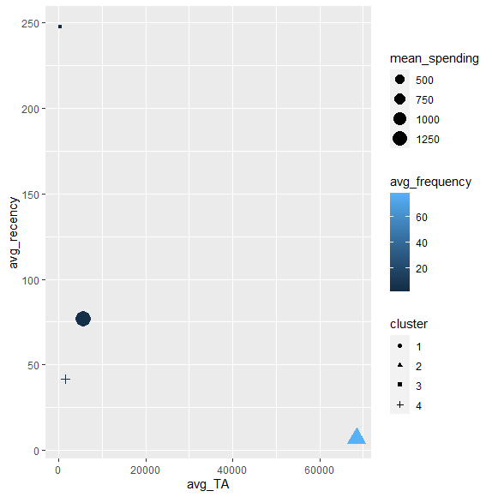
Cluster Plot
Features/ Variables description:
avg_recency: Average value of customer’s last transaction with the company in terms of number of days in a cluster.
avg_TA: Average value of total amount paid for goods purchased by the customers from each cluster.
avg_frequency: Average value of the no. of times customers from each cluster transacted with the company in the given time period of 374 days.
mean_spending: Average amount the customers from each cluster spent in transaction with the company.
clusters: Number of clusters was determined using the elbow method.
All variables are on a cluster-based average.

Slide 3
cluster | avg_TA | avg_recency | avg_frequency | mean_spending
1 | 68513.93 | 7.15 | 78.2 | 1237.7
2 | 5554.93 | 76.5 | 4.33 | 1367.02
3 | 1539.96 | 41.56 | 4.71 | 309.47
4 | 385.04 | 247.63 | 1.57 | 251.15
A recency of x indicates that the customer has made their last purchase x days ago. Therefore, lower value of recency is indicative of a more valuable customer because the more recently the customer has transacted with the company, the more likely that customer will be responsive to communications from the company and make a purchase.
Customers with higher frequency are more engaged and probably more loyal than those with less frequency.
Total Amount reflects how much the customer has spent purchasing products from the company.
Total Amount divided by frequency gives the mean spending of customers in each cluster.

Slide 4
Assigning Ranks
cluster | avg_TA | avg_recency | avg_frequency | mean_spending
1 | 1 | 1 | 1 | 2
2 | 2 | 3 | 3 | 1
3 | 3 | 2 | 2 | 3
4 | 4 | 4 | 4 | 4
Ranks assigned to each feature on a scale of 1-4.
1 being the highest and 4 the lowest.
This makes the segregation of customers convenient.

Slide 5
Cluster 1 Analysis
Average of total amount transacted with the company is 68513.93 which is ranked 1st.
Average of Recency of customers is 7.15 which is the lowest (Rank 1). Indicates that the customer’s last transaction with the company was only 7 days ago.
Highest Frequency of 78.80 in a period of 374 days means that customers from this cluster transacted with the company every week on an average basis which is again the highest, thus, rank 1.
Mean Spending is 1237.7, second highest among the four clusters, ranked 2nd.

Slide 6
Cluster 1 Analysis continued
This cluster comprises of the best customers as they transacted recently, do so often and spend more than the customers in other clusters.
Cluster 1 Score: 1-1-1-2
Ranked 1st in three out of four categories, which makes them our best “Champion Customers”.

Slide 7
Cluster 2 Analysis
Average of total amount transacted with the company is 5554.93 which is ranked 2nd .
Average of Recency of customers is 76.5 which is ranked 3rd . Indicates that the customer’s last transaction with the company was 76.5 days ago, pretty old.
Frequency of 4.33 in a period of 374 days means that customers from this cluster transacted with the company every three months on an average basis which is low, thus, rank 3.
Mean Spending is 1237.7, the highest among the four clusters, ranked 1st though the difference between the first and second is very less.

Slide 8
Cluster 2 Analysis continued
This cluster comprises of the customers who didn’t transact recently, do so rarely but have spent the highest in comparison with customers from other clusters.
Cluster 1 Score: 2-3-3-1
Customers from this group will fall either under Warm or Normal category.

Slide 9
Cluster 3 Analysis
Average of total amount transacted with the company is 1539.96 which is ranked 3rd.
Average of Recency of customers is 41.56 which is ranked 2nd. Indicates that the customer’s last transaction with the company was 42 days ago.
Frequency of 4.71 in a period of 374 days means that customers from this cluster transacted with the company every three months on an average basis which is low but still the second highest.
Mean Spending is 309 which is considerably low than 1st and 2nd clusters but a little higher than the 4th cluster.

Slide 10
Cluster 3 Analysis continued
This cluster comprises of the customers who transacted recently, do so rarely and do not spend as much in comparison with customers from other clusters.
Cluster 3 Score: 3-2-2-3
Customers from this group will fall either under Warm or Normal category.

Slide 11
Cluster 4 Analysis
Average of total amount transacted with the company is 385 which contributes only 0.51% of the total amount transacted, therefore ranked 4th.
Average of Recency of customers is 247.63 which is ranked 4th. Indicates that the customer’s last transaction with the company was a whooping 247 days ago, the oldest.
Frequency of 1.57 in a period of 374 days means that customers from this cluster transacted with the company only twice in a year.
Mean Spending is only 251. In 2 transactions with the company, customers from this group spent only 251 on an average, the lowest. Thus, ranked 4th.

Slide 12
Cluster 4 Analysis Continued
This cluster comprises of the least interested customers as they did not transact recently, barely do so and spend the least compared to customers in other clusters.
Cluster 1 Score: 4-4-4-4
Ranked last in all categories, which makes them our “Cold Customers”.

Slide 13
Cluster Score Interpretation
Cluster | Score | Segmentation
1 | 1-1-1-2 | Hot Customers / Champions | Best customers who bought most recently, most often and who spend heavily.
2 | 2-3-3-1 | Normal Customers/ At Risk | Customers who spend heavily, make few transactions but have not purchased recently.
3 | 3-2-2-3 | Warm customers/ Promising | Customers who have purchased recently, do so often but do not spend much.
4 | 4-4-4-4 | Cold Customers/ Lost | Customers who hardly transact, and when they do they spend very less.
Note: Recency and Frequency have a higher weightage than monetary value because even though the customer has spent less, he/she is a frequent and a recent customer, regardless of amount spent, thus valuable.

Slide 14
Suggestions
CLUSTER 1: These are our champion customers. We can give extra purchase points, special mentions on our social media pages or any kind of token of appreciation so that they continue to shop from our platform.
CLUSTER 2: This group of customer needs the most attention. It lies third on the both the frequency and recency field but have the highest mean spending of all the clusters and thus a valuable group, may contribute to the churn rate. We should do promotional offers especially for the type of products similar to the ones they are interested in and also take a look at their feedbacks and suggestions.

Slide 15
CLUSTER 3: These are potential loyal customers. We should encourage them to keep shopping with us by providing them special-limited time offers on products in their basket and by providing bundle-offers such as buy 2 get 1 free, shop for 2000 and get 500 free. Offers attract customers who tend to spend less.
CLUSTER 4: These are the cold customers and they will or already have contributed to the churn-rate. The best we can do is conduct a separate analysis to what went wrong in their case.

